Slide 1

Lazy Sequentialization
for TSO and PSO
via Shared Memory Abstractions
Ermenegildo Tomasco | University of Southampton, UK
Truc Lam Nguyen | University of Southampton, UK
Omar Inverso | Gran Sasso Science Institute, Italy
Bernd Fischer | Stellenbosch University, South Africa
Salvatore La Torre | Università di Salerno, Italy
Gennaro Parlato | University of Southampton, UK
FMCAD 2016, Mountain View, CA, USA

Slide 2
Relaxed Memory Consistency
sequential consistency (SC)
memory operations executed in program order within each thread
changes to the shared memory immediately visible to all threads
relatively simple to reason about but not realistic
weak memory models (WMMs)
memory operations may be reordered
used in practice to fully exploit modern hardware
SHARED MEMORY
t₁
…
t_{N}

Slide 3
Relaxed Memory Consistency
total store order (TSO)
writes executed in their order for each thread
reads may overtake writes
partial store order (PSO)
writes to the same location executed in their order for each thread
writes to different locations may be reordered
reads may overtake writes
SHARED MEMORY
STORE
BUFFER
STORE
BUFFER
t₁
…
t_{T}

Slide 4
Relaxed Memory Consistency
limitations of testing
generally ineffective for rare concurrency errors
cannot control additional nondeterminism introduced by WMMs
need to be complemented with symbolic analysis
SHARED MEMORY
STORE
BUFFER
STORE
BUFFER
t₁
…
t_{T}

Slide 5
Symbolic Bug Finding:
BMC
concurrency handling at formula level
encode threads separately
add φ_{c} to capture thread interleaving
[Sinha, Wang – POPL 2011]
P_{SC/WMM}
IR
VC
φ_{t} ∧ φ_{c}
TRUE
FALSE + CEX

Slide 6
Symbolic Bug Finding:
BMC
concurrency handling at formula level
encode threads separately
add φ_{c} to capture thread interleaving
[Sinha, Wang – POPL 2011]
extension to WMMs is natural
change φ_{c} to capture extra interactions due to weaker consistency
[Alglave, Kroening, Tautschnig – CAV 2013]
P_{SC/WMM}
IR
VC
φ_{t} ∧ φ_{c}
TRUE
FALSE + CEX

Slide 7
Symbolic Bug Finding:
Lazy Sequentialization + BMC
concurrency handling at code level
reduction to sequential programs analysis
implemented as source transformation
lazy sequentialization tailored to BMC for effective in bug-hunting
[Inverso, Tomasco, Fischer, La Torre, Parlato – CAV 2014]
P_{SC}
P_{SEQ}
IR
VC
φ
TRUE
FALSE + CEX

Slide 8
Symbolic Bug Finding:
Lazy Sequentialization + BMC
concurrency handling at code level
reduction to sequential programs analysis
implemented as source transformation
lazy sequentialization tailored to BMC for effective in bug-hunting
[Inverso, Tomasco, Fischer, La Torre, Parlato – CAV 2014]
how to extend to WMMs?
how does it compare?
P_{SC}
P_{SEQ}
IR
VC
φ
TRUE
FALSE + CEX

Slide 9
Extending Lazy Sequentialization
to TSO and PSO
how to extend to WMMs?
reduction to concurrent program analysis under SC
again, implemented as source transformation
P_{WMM}
P_{SC}
P_{SEQ}
IR
VC
φ
TRUE
FALSE + CEX

Slide 10
Extending Lazy Sequentialization
to TSO and PSO
how to extend to WMMs?
reduction to concurrent program analysis under SC
again, implemented as source transformation
replace shared memory access with explicit function calls to SMA API:
read(v,t), write(v,val,t)
lock(m,t), unlock(m,t), fence(t), …
example: x=y+3 is changed to write(x,read(y)+3)
P_{WMM}
P_{SC}
P_{SEQ}
IR
VC
φ
TRUE
FALSE + CEX

Slide 11
Extending Lazy Sequentialization
to TSO and PSO
how to extend to WMMs?
reduction to concurrent program analysis under SC
again, implemented as source transformation
replace shared memory access with explicit function calls to SMA API:
read(v,t), write(v,val,t)
lock(m,t), unlock(m,t), fence(t), …
example: x=y+3 is changed to write(x,read(y)+3)
plug in implementation for specific semantics
TSO-SMA - simple implementation
eTSO-SMA - efficient implementation
PSO-SMA - extension to PSO
P_{WMM}
P_{SC}
P_{SEQ}
IR
VC
φ
TRUE
FALSE + CEX

Slide 12
TSO-SMA
simple simulation of the store buffer
introduce one array for each thread
read(v,t)
look up buffer for pending writes
fetch from memory
write(v,val,t)
update store buffer
inject nondeterministic memory flush
SHARED MEMORY
STORE
BUFFER
STORE
BUFFER
t₁
…
t_{T}

Slide 13
TSO-SMA
simple simulation of the store buffer
introduce one array for each thread
read(v,t)
look up buffer for pending writes
fetch from memory
write(v,val,t)
update store buffer
inject nondeterministic memory flush
SHARED MEMORY
STORE
BUFFER
STORE
BUFFER
t₁
…
t_{T}
formula size depends
on store buffer size

Slide 14
TSO-SMA
simple simulation of the store buffer
introduce one array for each thread
read(v,t)
look up buffer for pending writes
fetch from memory
write(v,val,t)
update store buffer
inject nondeterministic memory flush
SHARED MEMORY
STORE
BUFFER
STORE
BUFFER
t₁
…
t_{T}
formula size depends
on store buffer size
formula size proportional to
no. memory accesses
no. of store buffers
max no. of elems in the buffer

Slide 15
eTSO-SMA
efficient simulation of the store buffer
introduce one list for each shared variable and thread
use global clock and timestamp memory writes
read(v,t)
buffer look up, return value from latest pending write
return value from latest expired write
write(v,val,t)
guess timestamp, enforce non-decreasing order
update buffer
SHARED MEMORY
l_{1,1}
l_{1,V}
l_{1,1}
l_{1,V}
l_{1,1}
…
l_{1,V}
l_{T,1}
…
l_{T,V}
t₁
…
t_{T}

Slide 16
eTSO-SMA
efficient simulation of the store buffer
introduce one list for each shared variable and thread
use global clock and timestamp memory writes
read(v,t)
buffer look up, return value from latest pending write
return value from latest expired write
write(v,val,t)
guess timestamp, enforce non-decreasing order
update buffer
SHARED MEMORY
l_{1,1}
l_{1,V}
l_{1,1}
l_{1,V}
l_{1,1}
…
l_{1,V}
l_{T,1}
…
l_{T,V}
t₁
…
t_{T}
constant size
constant size

Slide 17
Variable Write Lists (T-CDLL)
store pairs (value,timestamp)
clock determines expired nodes
expired nodes not removed
special nodes
sentinel node
has max timestamp
does not correspond to any actual write
head
only node to contain an expired write
followed by a non-expired write

Slide 18
Variable Write Lists (T-CDLL)
store pairs (value,timestamp)
clock determines expired nodes
expired nodes not removed
special nodes
sentinel node
has max timestamp
does not correspond to any actual write
head
only node to contain an expired write
followed by a non-expired write
head
sentinel

Slide 19
Variable Write Lists (T-CDLL)
store pairs (value,timestamp)
clock determines expired nodes
expired nodes not removed
special nodes
sentinel node
has max timestamp
does not correspond to any actual write
head
only node to contain an expired write
followed by a non-expired write
head
sentinel
expired nodes
actual variable write list

Slide 20
Auxiliary Data Structures
parameters
T max no. of threads
V max no. of tracked locations (or write lists)
N max no. of nodes for each variable write list
K max timestamp
variables
int clock;
variable write lists
int value[V][N+1],
tstamp[V][N+1],
prev[V][N+1],
next[V][N+1];
last values and timestamps
int last_value[V][T],
last_tstamp[V][T];
max timestamp so far
int max_tstamp[T];

Slide 21
eTSO-SMA: read operation
int clock_update() {
int tmp = *;
assume(clock <= tmp && tmp <= K);
clock = tmp;
}
int read(int v, int t) {
clock_update();
if (last_tstamp[v][t] > clock)
return last_value[v][t];
int node = *;
assume(node < N &&
tstamp[v][node] <= clock &&
tstamp[v][next[v][node]] > clock);
return value[v][node];
}

Slide 22
eTSO-SMA: read operation
int clock_update() {
int tmp = *;
assume(clock <= tmp && tmp <= K);
clock = tmp;
}
int read(int v, int t) {
clock_update();
if (last_tstamp[v][t] > clock)
return last_value[v][t];
int node = *;
assume(node < N &&
tstamp[v][node] <= clock &&
tstamp[v][next[v][node]] > clock);
return value[v][node];
}
clock follows
non-decreasing order

Slide 23
eTSO-SMA: read operation
int clock_update() {
int tmp = *;
assume(clock <= tmp && tmp <= K);
clock = tmp;
}
int read(int v, int t) {
clock_update();
if (last_tstamp[v][t] > clock)
return last_value[v][t];
int node = *;
assume(node < N &&
tstamp[v][node] <= clock &&
tstamp[v][next[v][node]] > clock);
return value[v][node];
}
clock follows
non-decreasing order
if the last write by t on v has not expired,
return the corresponding value

Slide 24
eTSO-SMA: read operation
int clock_update() {
int tmp = *;
assume(clock <= tmp && tmp <= K);
clock = tmp;
}
int read(int v, int t) {
clock_update();
if (last_tstamp[v][t] > clock)
return last_value[v][t];
int node = *;
assume(node < N &&
tstamp[v][node] <= clock &&
tstamp[v][next[v][node]] > clock);
return value[v][node];
}
clock follows
non-decreasing order
if the last write by t on v has not expired,
return the corresponding value
return the value from the latest expired write,
which is guaranteed to exist and
correspond to the value of v in the memory

Slide 25
eTSO-SMA: read operation
int clock_update() {
int tmp = *;
assume(clock <= tmp && tmp <= K);
clock = tmp;
}
int read(int v, int t) {
clock_update();
if (last_tstamp[v][t] > clock)
return last_value[v][t];
int node = *;
assume(node < N &&
tstamp[v][node] <= clock &&
tstamp[v][next[v][node]] > clock);
return value[v][node];
}
clock follows
non-decreasing order
if the last write by t on v has not expired,
return the corresponding value
return the value from the latest expired write,
which is guaranteed to exist and
correspond to the value of v in the memory
representation
of the memory
no longer needed

Slide 26
eTSO-SMA: write operation
select expired node with min timestamp for the new write
int write(int v, int t) {
clock_update();
int node = next[v][N];
assume(tstamp[v][next[v][node]] <= clock);
next[v][N] = next[v][node];
prev[v][next[v][N]] = N;
int succ = *;
assume(succ <= N && tstamp[v][succ] > clock);
int pred = prev[v][succ];
int ts = *;
assume(ts >= clock && ts >= max_tstamp[t]);
assume(ts >= tstamp[v][pred] && ts < tstamp[v][succ]);
value[v][node] = val;
tstamp[v][t] = ts;
…
last_tstamp[v][t] = ts;
last_value[v][t] = val;
max_tstamp[t] = ts;
}

Slide 27
eTSO-SMA: write operation
select expired node with min timestamp for the new write
int write(int v, int t) {
clock_update();
int node = next[v][N];
assume(tstamp[v][next[v][node]] <= clock);
next[v][N] = next[v][node];
prev[v][next[v][N]] = N;
int succ = *;
assume(succ <= N && tstamp[v][succ] > clock);
int pred = prev[v][succ];
int ts = *;
assume(ts >= clock && ts >= max_tstamp[t]);
assume(ts >= tstamp[v][pred] && ts < tstamp[v][succ]);
value[v][node] = val;
tstamp[v][t] = ts;
…
last_tstamp[v][t] = ts;
last_value[v][t] = val;
max_tstamp[t] = ts;
}
position the new node by nondeterministically selecting its successor among the non-expired nodes

Slide 28
eTSO-SMA: write operation
select expired node with min timestamp for the new write
int write(int v, int t) {
clock_update();
int node = next[v][N];
assume(tstamp[v][next[v][node]] <= clock);
next[v][N] = next[v][node];
prev[v][next[v][N]] = N;
int succ = *;
assume(succ <= N && tstamp[v][succ] > clock);
int pred = prev[v][succ];
int ts = *;
assume(ts >= clock && ts >= max_tstamp[t]);
assume(ts >= tstamp[v][pred] && ts < tstamp[v][succ]);
value[v][node] = val;
tstamp[v][t] = ts;
…
last_tstamp[v][t] = ts;
last_value[v][t] = val;
max_tstamp[t] = ts;
}
position the new node by nondeterministically selecting its successor among the non-expired nodes
guess suitable timestamp,
must respect non-decreasing order

Slide 29
eTSO-SMA: write operation
select expired node with min timestamp for the new write
int write(int v, int t) {
clock_update();
int node = next[v][N];
assume(tstamp[v][next[v][node]] <= clock);
next[v][N] = next[v][node];
prev[v][next[v][N]] = N;
int succ = *;
assume(succ <= N && tstamp[v][succ] > clock);
int pred = prev[v][succ];
int ts = *;
assume(ts >= clock && ts >= max_tstamp[t]);
assume(ts >= tstamp[v][pred] && ts < tstamp[v][succ]);
value[v][node] = val;
tstamp[v][t] = ts;
…
last_tstamp[v][t] = ts;
last_value[v][t] = val;
max_tstamp[t] = ts;
}
position the new node by nondeterministically selecting its successor among the non-expired nodes
guess suitable timestamp,
must respect non-decreasing order
update variable write list and auxiliary variables

Slide 30
extension to PSO
int write(int v, int t) {
clock_update();
int node = next[v][N];
assume(tstamp[v][next[v][node]] <= clock);
next[v][N] = next[v][node];
prev[v][next[v][N]] = N;
int succ = *;
assume(succ <= N && tstamp[v][succ] > clock);
int pred = prev[v][succ];
int ts = *;
assume(ts >= clock && ts >= max_tstamp[t]);
assume(ts >= tstamp[v][pred] && ts < tstamp[v][succ]);
value[v][node] = val;
tstamp[v][t] = ts;
…
last_tstamp[v][t] = ts;
last_value[v][t] = val;
max_tstamp[t] = ts;
}
write to different variables may be reordered, guessed timestamps no longer need to be the maximum over all variables, but the maximum for the relevant variable:
ts >= last_tstamp[t][v]

Slide 31
extension to PSO
int write(int v, int t) {
clock_update();
int node = next[v][N];
assume(tstamp[v][next[v][node]] <= clock);
next[v][N] = next[v][node];
prev[v][next[v][N]] = N;
int succ = *;
assume(succ <= N && tstamp[v][succ] > clock);
int pred = prev[v][succ];
int ts = *;
assume(ts >= clock && ts >= max_tstamp[t]);
assume(ts >= tstamp[v][pred] && ts < tstamp[v][succ]);
value[v][node] = val;
tstamp[v][t] = ts;
…
last_tstamp[v][t] = ts;
last_value[v][t] = val;
max_tstamp[t] = ts;
}
write to different variables may be reordered, guessed timestamps no longer need to be the maximum over all variables, but the maximum for the relevant variable:
ts >= last_tstamp[t][v]
guessed timestamps may be smaller than the max timestamp:
max_tstamp[t] = max(max_tstamp[t],ts)

Slide 32
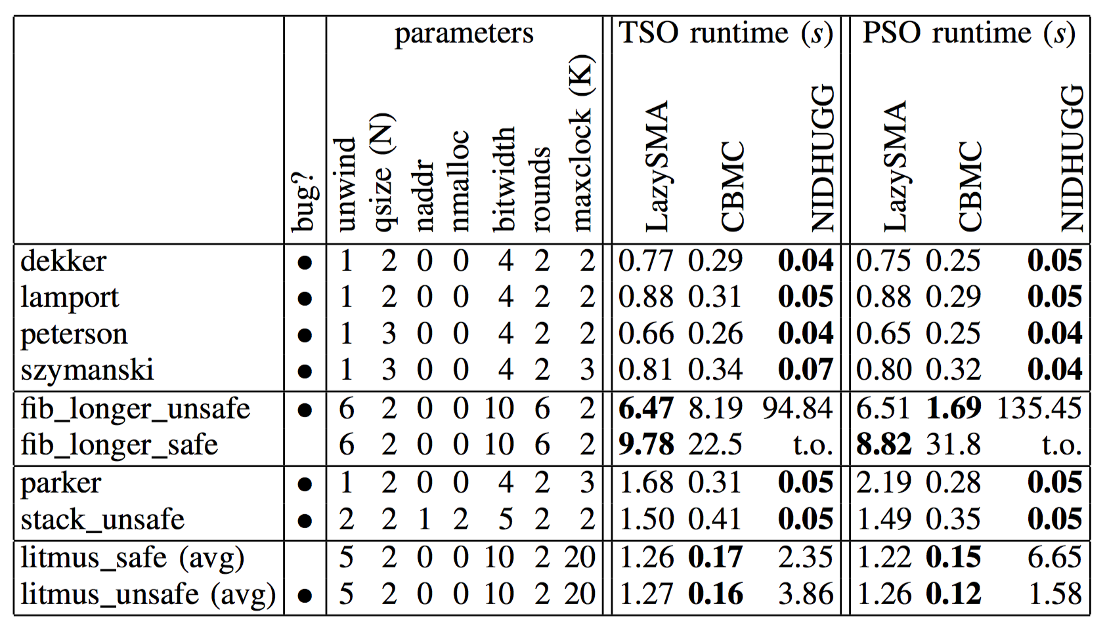
Experimental Evaluation: common benchmarks
timeout = 600s
transformation overhead shows on small programs

Slide 33
Experimental Evaluation: common benchmarks
timeout = 600s
competitive on twisted interleavings

Slide 34
Experimental Evaluation: common benchmarks
timeout = 600s
slower

Slide 35
Experimental Evaluation: common benchmarks
timeout = 600s
faster than Nidhugg

Slide 36
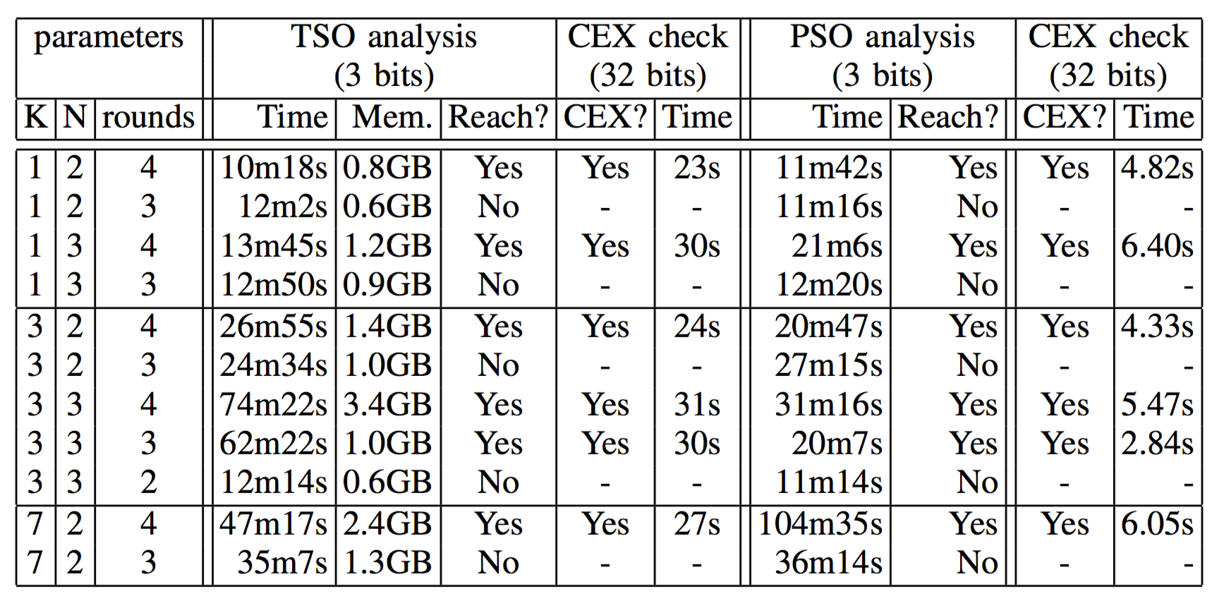
Experimental Evaluation: Safestack
maxclock=K=1 forces SC analysis,
TSO puts 3x-4x overhead on lazy schema (SC times not shown in table)

Slide 37
Experimental Evaluation: Safestack
quicker to spot the bug under PSO
as it requires a smaller number of thread interactions;
performance comparable when no bugs are found

Slide 38
Experimental Evaluation: Safestack
increase maxlock to covers more reorderings,
more resource demanding..

Slide 39
Thank You
users.ecs.soton.ac.uk/gp4/cseq

